Slide 1
Data Science Training
June 2022

Slide 2





Agenda
Data Science and Python Introduction
Data Preparation
Exploratory Data Analysis
Data Visualization
Feature Engineering & Selection
Supervised Learning
Neural Networks
Unsupervised Learning
Tuning, Validation & Testing
Final Exam

Slide 3
Data Science Training
Data Visualization
June 2022

Slide 4
Agenda
01
Introduction
02
Data Visualization
03
Practice

Slide 5

Two Aspects of Data Exploration
Statistical analysis
The use of statistical descriptors and tests supports the data understanding and helps assessing if it holds certain assumptions
Explorative Data
Analysis
Data visualization
Data visualization is one of the most powerful and appealing techniques for data exploration
Humans have a well-developed ability to analyze large amounts of information that is presented visually
Can detect general patterns and trends
Can detect outliers and unusual patterns
5

Slide 6
Agenda
01
Introduction
02
Data Visualization
03
Practice

Slide 7
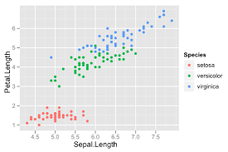
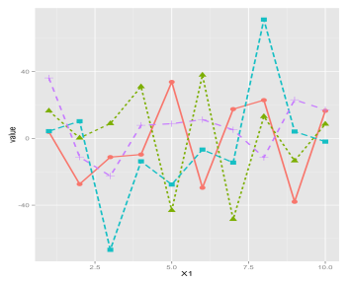
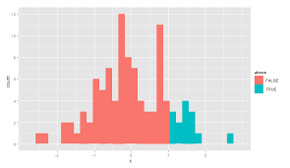
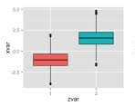
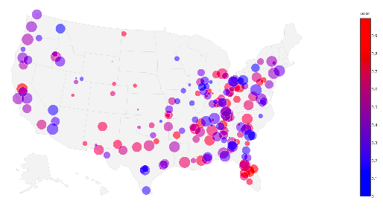
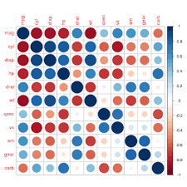
Exploratory Data Analysis Toolset
Data often require the use of correct aggregation & visualization: excessive granularity may not be effective and, on the other hand, some statistical plot may be more useful then others.
Bar Plot &
Histogram
Scatter Plot
Line Chart
Box-Plot
Map
Heat Map
Visualize single data points in 2D charts
Visualize trend, especially useful for time series
Visualize data distribution per classes
Visualize data dispersion and summary statistics
Visualize geo-spatial data onto a geographic map
Visualize data colored on an attribute value basis
7

Slide 8
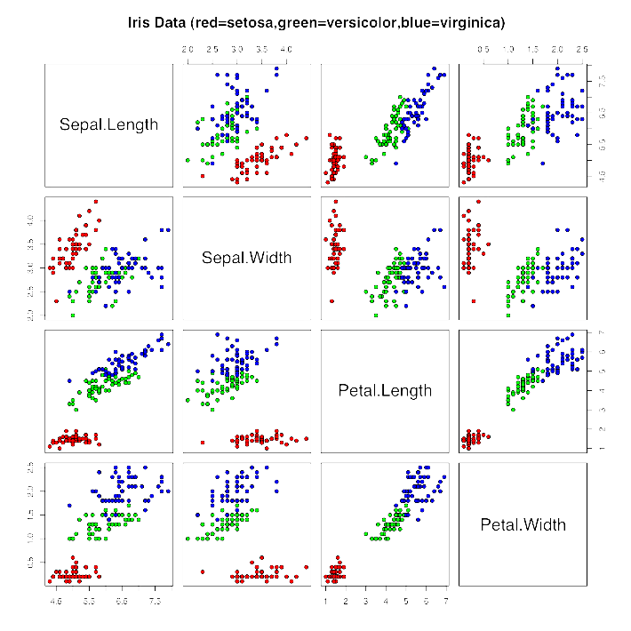
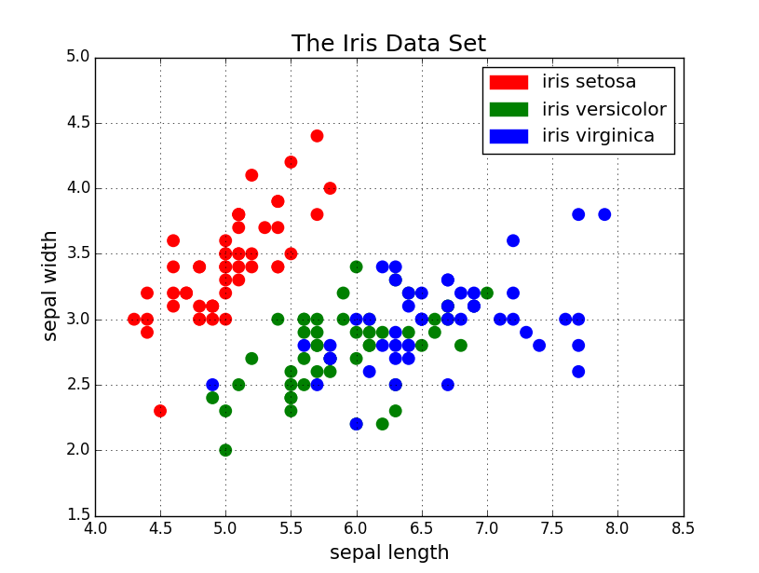
Scatter Plots
Attributes values determine points positions
Often additional attributes can be displayed by using the size, shape, and color of the markers that represent the objects
It is useful to have arrays or matrices of scatter plots can compactly summarize the relationships of several pairs of attributes
8

Slide 9
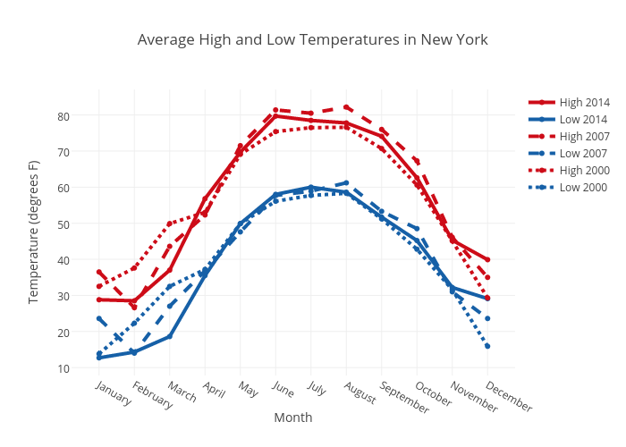
Line Charts
Line graphs are used to track changes over short and long periods of time (especially useful for time-series data)
When smaller changes exist, line graphs are better to use than bar graphs
Line graphs can also be used to compare changes over the same period of time for more than one group
9

Slide 10
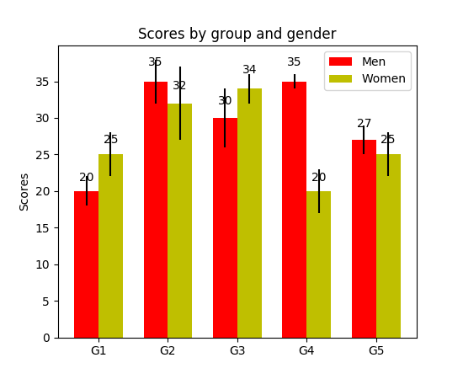
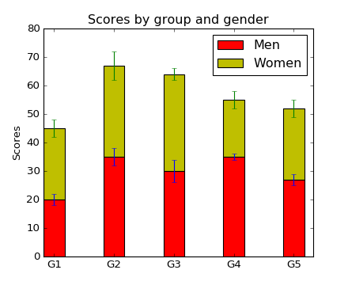
Bar Plots
They use horizontal or vertical bars to compare categories
One axis shows the compared groups, the other axis represents a discrete value
Some bar graphs present bars clustered in groups of more than one (grouped bar graphs), and others show the bars divided into subparts to show cumulate effect (stacked bar graphs)
Can be enriched with additional information such as the variance
10

Slide 11
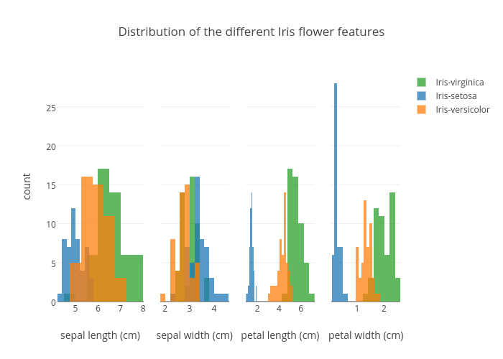
Histograms
They are a graphical representation of the distribution of data introduced by Karl Pearson in 1895
They estimate the probability distribution of a continuous variables
They are representations of tabulated frequencies depicted as adjacent rectangles, erected over discrete unseparated intervals (bins). Their areas are proportional to the frequency of the observations in the interval.
11

Slide 12
Histograms: Binning
Equal-width (distance) partitioning:
It divides the range into N intervals of equal size: uniform grid
Outliers may dominate presentation: skewed data is not handled well
Equal-depth (frequency) partitioning:
It divides the range into N intervals, each containing approximately the same number of samples
Good data scaling, but managing categorical attributes can be tricky
Frequency
Frequency
EQUAL WIDTH | # | AVG
[0-25) | 8 | 9.38
[25-50) | 8 | 38.63
[50-75) | 11 | 63.64
[75-100) | 3 | 94.00
TOT | 30 | 45.53
EQUAL DEPHT | # | AVG
I | 10 | 13.50
II | 10 | 47.30
III | 10 | 75.80
TOT | 30 | 45.53
12

Slide 13
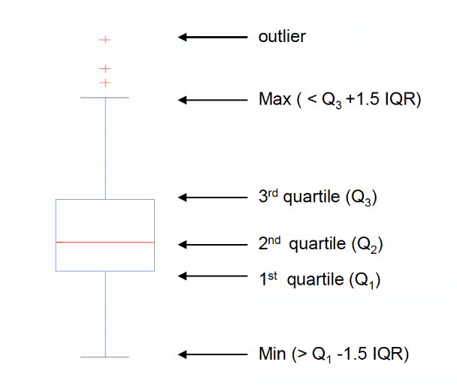
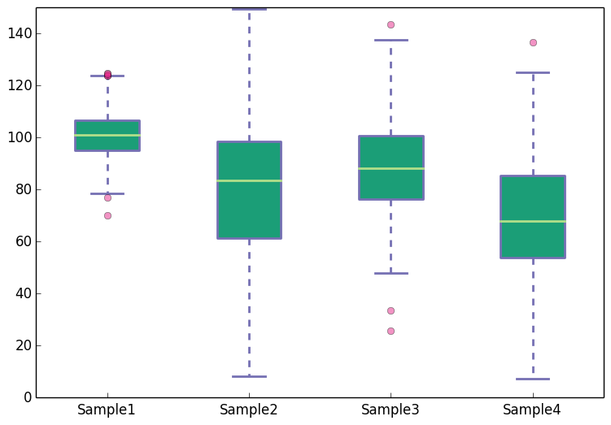
Box-Plots
Standardized way of displaying the distribution of data based on the five number summary: minimum (Min), first quartile (Q1), median (Q2), third quartile (Q3), and maximum (Max)
IQR is the interquartile range or Q3-Q1
Outliers are easily spotted as they are represented as points over the Max segment: Q3 + 1.5*IQR
13

Slide 14

Maps
Maps are a very effective communications tool that can visualize thousands of data points in just one figure
Objects are often represented as points
Their attribute values can be represented as the position of the points or the characteristics of the points, e.g., color, size, and shape
14

Slide 15
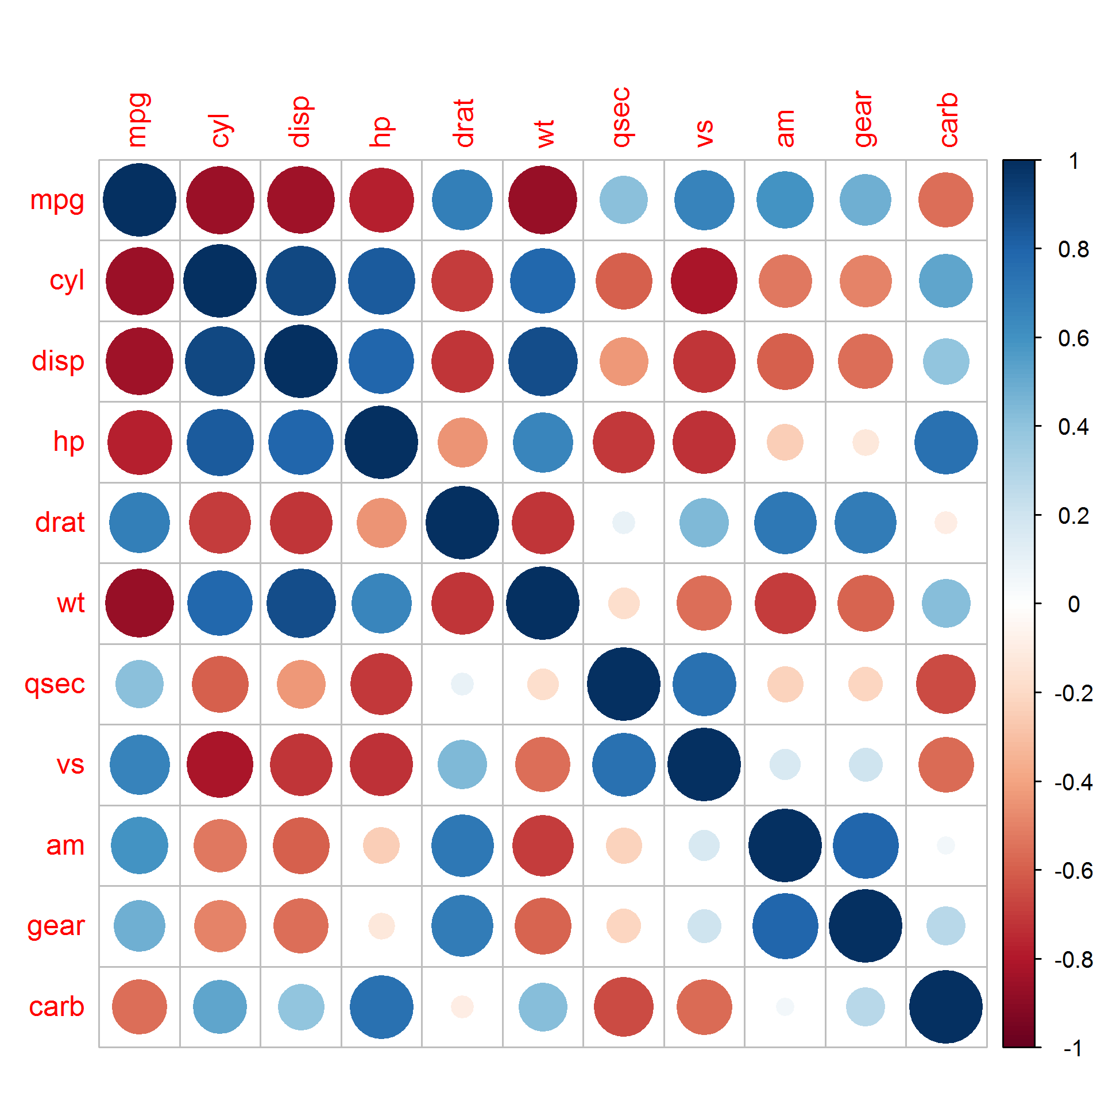
Heatmaps
Graphical representation of data where the individual values contained in a matrix are represented as colors
A simple heat map provides an immediate visual summary of information, while more elaborate heat maps allow the viewer to understand complex data sets
Useful to spot correlation between features in a dataset
15

Slide 16
Agenda
01
Introduction
02
Data Visualization
03
Practice

Slide 17
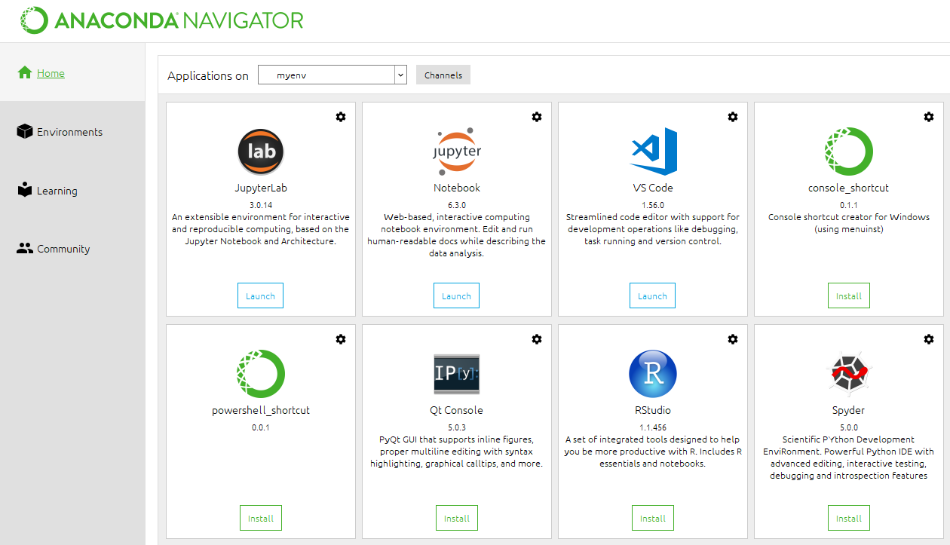
Launch Jupyter Notebook through Anaconda Navigator
Open Windows search bar again and run Anaconda Navigator. Once the application has started, launch Jupyter Notebook.
17

Slide 18
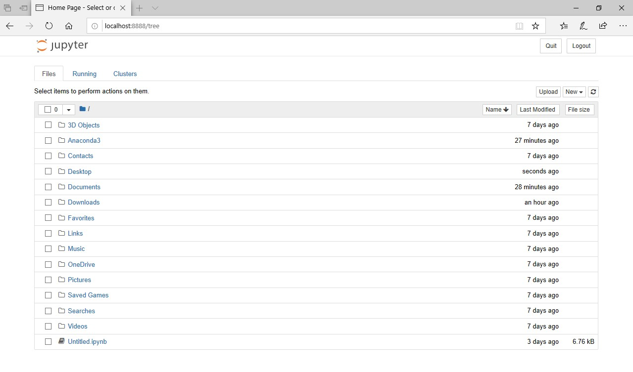
Open ► Day 4 - Data Visualization.ipynb
If you see a browser page as the example below, Jupyter Notebook is correctly running on the machine.
18

